Slide 2
Reporting
Ignite World Wide Tour
Microsoft Corporation

Slide 3
Agenda
Reporting Database (RDB) Enhancements
Business Intelligence Center
Excel Services
Multiple OLAP Databases
Performance Point Services
Visio Services
Power Pivot (part of SQL Server 2008 R2) and SQL Reporting Services

Slide 4
Expectations for reporting in 2010
Reporting database
OLAP Cubes
SharePoint Server 2010 Platform
BI Center
Excel Services, Visio Services, Performance Point Services…
“Traditional” SQL Server Reporting services
No Office Web Components (OWA)

Slide 5


Project Server Database Architecture
Transaction
Reporting
Archive
Metadata Edit
IT
Decisional
HR
Decisional
Marketing
Decisional
Backup/Restore
Draft
Publish
Analysis Services Databases Build
Metadata Edit
Reporting
Relational
Publish
SharePoint
Relational

Slide 6
Choose the Data Source
Relational
(Reporting DB)
Decisional
(Analysis Services Cubes)
Up-to-date data
Superset of data available in the AS cubes
No drilldown required in report
Aggregation across dimension(s)
Efficient for reports on time phased data
Key Performance Indicators

Slide 7
Data Source Customization
Reporting Database
Leverage documented schema in the SDK
Custom query for complex reports
Reporting Data Service Events
Do not modify out of box schema
Querying against SQL tables on a large data set could be slow!

Slide 8
Data Source Customization
Analysis Services Databases
Multiple Databases
Flexibility in data within the Database
Department level filtering for data in the cubes
Add new dimensions and/or measures
Add calculated measures through PWA
Analysis Management Objects (AMO) hooked to the CubeProcessed event handler

Slide 9
Reporting Database enhancements

Slide 10
RDB : Portfolio Data
With the integration of Project Portfolio Server functionality into Project Server 2010 in this release, Portfolio data elements were added to the Reporting Database
Portfolio Data Tables
MSP_EPMENTERPRISEPROJECTTYPE
MSP_EPMOPTIMIZERDECISIONTYPE
MSP_EPMPLANNERDECISIONTYPE
MSP_EPMPROJECTCOMMIT
MSP_EPMWORKFLOWPHASE
MSP_EPMWORKFLOWSTAGE
MSP_EPMWORKFLOWSTATUSINFORMATION
MSP_EPMWORKFLOWSTATUSTYPE
Notes:
RDB = Reporting Database
Portfolio Data
With the integration of Project Portfolio Server functionality into Project Server 2010 in this release, Portfolio data elements were added to the Reporting Database. These data elements include:
Workflow
Drivers
Commit Table Entries
Project Impact Values
Driver Prioritizations
Planner Requirements By Role
Planner Capacity By Role
Planner Rates By Role

Slide 11
RDB : Timesheets
Timesheet custom field data is now populated in the Reporting Database enabling more granular reporting over timesheet data
Administrative time added to make it easier to calculate resource availability
Notes:
RDB = Reporting Database
Admin time was always available (in the TS schema) the difference is now we create a dummy project for “working” admin time to make it easier to calc availability
This, combined with the new “Combined Work” value in the _userviews means that availability = capacity (from resourcebyday) – assigned work (from assignmentbyday)
Rather than the complex join onto the TS schema to get admin time
And the calc to work out whether to use the resplan of the assignments)

Slide 12
RDB Addition : Project Properties
Project Properties entered in Project Professional 2010 are now available in the Reporting Database
Easier to leverage in report page headers/trailers, and keywords to ease search
Table | Column
MSP_EPMPROJECT | ENTERPRISEPROJECTTYPEUID
MSP_EPMPROJECT | PROJECTCATEGORYNAME
MSP_EPMPROJECT | PROJECTCOMPANYNAME
MSP_EPMPROJECT | PROJECTDESCRIPTION
MSP_EPMPROJECT | PROJECTKEYWORDS
MSP_EPMPROJECT | PROJECTSUBJECT
MSP_EPMPROJECT | PROJECTTITLE
Notes:
RDB = Reporting Database

Slide 13
RDB : Combined Work Contours
In Microsoft Office Project Server 2007, calculating the exact work assigned to a resource involved decoding application logic in the SQL statement and resulted in complex, non-performant queries
Project Server 2010 has improved storage of time-phased work in RDB
“Combined Work” value in the AssignmentbyDay_UserView
availability = capacity (from resourcebyday) – combined work (from assignmentbyday)
Eliminates need for complex SQL joins to calculate work
Notes:
RDB = Reporting Database

Slide 14
Summary
Existing reports against Reporting DB should still work
Same Schema for RDB

Slide 15
BUSINESS INTELLIGENCE center

Slide 16
Business Intelligence Center
A sub-site of the Project Web Access site
Same security permissions as PWA site
Inheritance may be disabled so that Report Center security may be managed manually
Hybrid mode – you can grant additional permissions

Slide 17
Out Of the Box Reports
Sample Reports | Templates
Deliverables | DependentProjects
IssuesAndRisks | Issues
MilestonesDueThisMonth | ProjectsAndAssignments
RejectedProjectList | ProjectsAndTasks
ResourceCapacity | Resources
SimpleProjectList | Risks
TimesheetActuals | Timesheet
TopProjects
WorkflowChart
WorkflowDrillDown

Slide 18
Out Of the Box Data Connections and Cubes
Reporting Database (RDB) - Office Data Connection Files | Analytical Database (OLAP) - Cubes
Project Server - Project Assignment Data | Assignment Non Timephased
Project Server - Deliverables | Assignment Timephased
Project Server - Issue Data | Deliverables
Project Server - Project And Task Data | EPM Timesheet
Project Server - Rejected Projects List | Issues
Project Server - Resource Capacity | MSP_Portfolio_Analyzer
Project Server – Resource Data | MSP_Project_SharePoint
Project Server - Risk Data | MSP_Project_Timesheet
Project Server - Simple Projects List | Project Non Timephased
Project Server - Timesheet Data | Resource Non Timephased
Project Server - Top Projects Data | Resource Timephased
Project Server - Workflow Chart Data | Risks
Project Server - Workflow Drilldown Data | Task Non Timephased
 | Timesheet

Slide 19
Business Intelligence Center Consideration for customization
Renaming or deleting default content and folders is not recommended
Microsoft updates ( service packs and patches ) may update and/or recreate default content/folders

Slide 20
Business Intelligence Center OLAP Integration
When OLAP Database is created, the following is created in the Reports folder:
Office Data Connection
Excel Reporting template is created
This data connected blank template will help you to quickly create new reports based on the new OLAP Database

Slide 21
DEMO
SharePoint BI Center

Slide 22
Demo <BI Center Configuration>
Create Windows domain groups for report viewing and report authoring
Add these groups to SQL Server as a logins
Grant the logins db_datareader to the EPM Reporting database
Configure BI Center reporting
Add a SQL Server login for the report authors group
Determine the data connection library URL
Set up trusted data connection libraries
Configure the Microsoft Secure Store Service

Slide 23
Excel Services

Slide 24
Excel Services
Security
The unattended account
Default trusted locations
Management
PowerShell - SPServiceApplication
Delegate services permissions
Collaboration
Multi-user collaboration
Slicer feature in Excel 2010
Gemini
SQL Server 2008 R2 Analysis Services
Slicer feature in Excel 2010

Slide 25
Out-of-the box reporting …for Project 2010
Office Web Components (OWC) 2003 were deprecated as of Office 2007
OWC will not ship with Project Server 2010
Excel Services is the new default reporting experience
Project Server 2010 Excel Services reports and Office Data Connections are included as built-in functionality in the BI Center
Customizable

Slide 26
Benefits of Excel Services
Easy sharing of data both inside and outside your corporate environment
Reports presented via web interface
Wide availability authoring tool
Office Excel 2007 or Excel 2010 client
Most IW Report Authors are familiar with core Excel functionality (Pivot Tables/Charts)
Notes:
Facilitates easy sharing of data both inside and outside your corporate environment
It enables Personal BI and Team BI scenarios of the BI continuum
These scenarios focus on enabling users to serve their own Business Intelligence needs
Data can be shared via web interface using Excel Services
Data can be distributed via XLSX files via email or some other facility and using Excel client for viewing
Files can be static snapshots of the web view, allowing you to share broadly or to modify the data for your own uses
Files can also remain data connected, allowing the user to refresh the data as needed, using the client. Note, this functionality requires IW Report Author level security.
Wide availability of requisite authoring client
This experience requires the Office Excel 2007 or Excel 2010 client.
Most IW Report Authors are already familiar with core Excel functionality (Pivot Tables/Charts)

Slide 27
Excel Services - Other Key Facts
Custom fields won’t show up automatically
Need to be added manually to RDB ODCs
Tradeoff between localization and custom fields
We will have more documentation on this
Localized report templates are created in separate folders
One for each language
Departments filter OLAP but not RDB out of box

Slide 28
Excel Services and REST API

Slide 29
What is REST?
An “architectural style”
Stands for “Representational State Transfer”
Focus on decoupling, scalability, layering
Resource centric approach
Data organized as addressable resources
Uniform interface to act on them
REST over HTTP is the typical setup

Slide 30
Excel Services – REST API
Custom applications are created with user-defined functions (UDFs) - these functions remain available for Excel Services.
RESET is an additional method available to build custom applications:
REST API – The REST API is a client server software architecture/protocol that defines entities and how to access them
This API uses hyperlinks and is stateless
REST lets the user access entities (ranges, charts) in workbooks using Excel Services through the HTTP protocol and also provides a method for users to set values in these ranges, including single cells

Slide 31
REST
http://server/_vti_bin/ExcelRest.aspx/Shared%20Documents/File.xlsx/Model/Ranges(‘Sheet!A1’)
Handler – the ASPX that handles all Excel Services REST requests
Name of the file as you would access it in SharePoint
Path inside the workbook.
Resource Name | Allows access to…
/Model | The workbook (the binary or the available feeds)
/Model/Ranges | List of named ranges in a workbook (some of them)
/Model/Ranges(‘RangeName’) | Specific range.
/Model/Charts | List of charts
/Model/Charts(‘ChartName’) | Specific Chart
/Model/Tables | List of tables (Lists)
/Model/Tables(‘TableName’) | Specific table
/Model/PivotTables | List of PivotTables
/Model/PivotTables(‘PivotName’) | Specific PivotTable

Slide 32
Excel services configuration

Slide 33


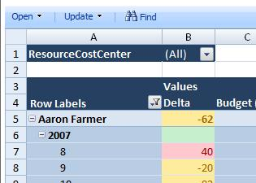

Configure Excel Services and Secure Store Configure Relational and Analysis DB access
Project Web Access -> Business Intelligence Center
Excel Workbook
Excel
Services
Secure Store
Application Profiles
Office Data Connection
Database Server
Reporting
DB
Analysis
DB

Slide 34
Excel Services - Security Setup
Report Author
Report Consumer
Excel Client does not use Secure Store Service (SSS)
Requires direct authentication against SQL
Setup author group with db_datareader rights to RDB
Excel Services uses Secure Store Service (SSS)
Setup app profile in SSS with service profile that has db_datareader rights
Authenticate the security group of users to use the profile

Slide 35
DEMO
Excel Services
Using REST

Slide 36
<Demo – Excel Services Setup>
Walk through the steps required to get Excel Services going with the built-in PWA reports and ODC’s.
Explain how to create a dashboard with the OOB reports and ODC’s
Explain how OOB and ODC’s are configured

Slide 37
Multiple OLAP Databases

Slide 38



The Progression of Analytic Data
 | Project 2003 | Project 2007 | Project 2010
OLAP Analysis Databases | 1 | 1 | Many
Cubes within the Analysis Database | 1 | 14 | 14
Multiple databases provide better support of non-Project users in other departments.
Multiple cubes provide richer views of the data

Slide 39
Multiple OLAP Databases Overview
Breaks down the EPM cube build process into different chunks
Departmental filtering
More Admin control
Departmental filtering of cubes
Control over intrinsic (out-of-the-box) fields included in cube builds
Multi-Language Support
Based on the Language Packs installed

Slide 40
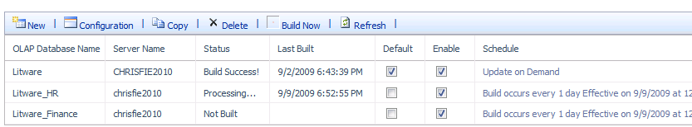
Multiple OLAP Databases
Project Web Access -> Server Settings -> OLAP Database Management

Slide 41
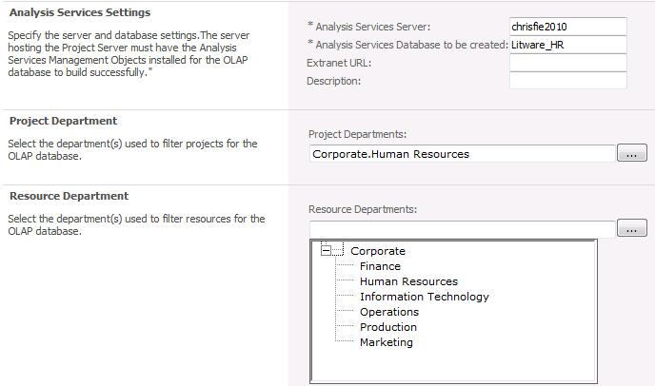
Multiple OLAP Databases
Cubes may be trimmed by Project Departments
Cubes may be trimmed by Resource Departments
Notes:
secure access – only people with the global permission who are in the resource dept are given access
Sales Dept
Sales Dept (DE)
Sales Dept (FR)
You might build a cube with all sales dept projects but only resources (and hence timesheets) from one country in the case where timesheet data is governed by work council rules and shouldn’t be seen except by authorized, in-country users.
Another example is for shared resources who work across depts. – the projects may not be in their dept…

Slide 42
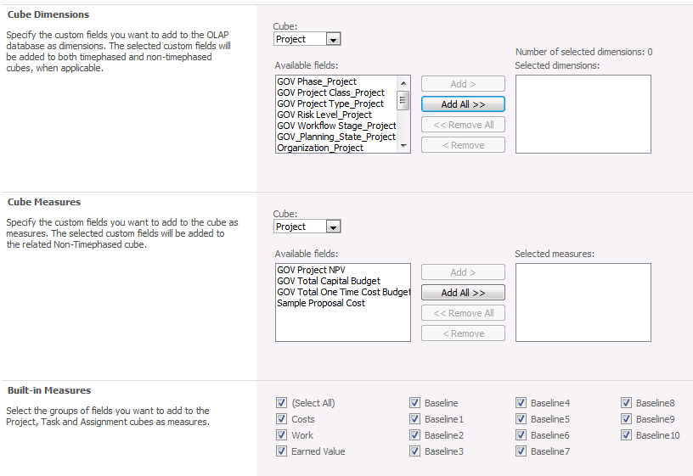
Multiple OLAP Databases
Cubes may be trimmed by Dimensions and Measures

Slide 43
Multiple OLAP Databases Departments
Departments may be associated with Projects, Resources
A cube could only include projects and resources that are associated with one or more Departments
Project and Resource departments may also be added into the cubes as dimension data for reporting purposes

Slide 44
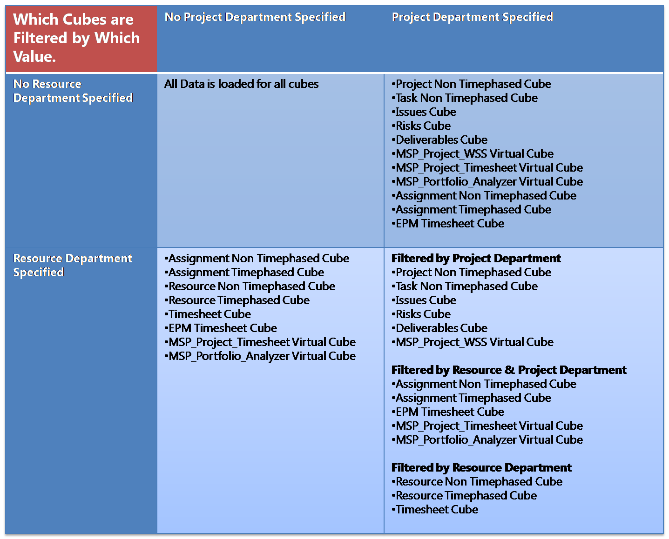
Departments and OLAP
Notes:
The subset of projects and resources will be used to filter at the project and timesheet level as follows:
Project Non Timephased:
The data in this cube will be filtered by the departmental project list.
Projects with assignments to the department’s resources will be included.
Task Non Timephased
Non-departmental tasks with assignments to the department’s resources will be included.
Note, the full non-departmental project will not be included.
All tasks for departmental projects will be included.
Assignment Non Timephased
Non-departmental project assignments for the department’s resources will be included.
All assignments for departmental projects will be included.
Assignment Timephased
Non-departmental project assignments for the department’s resources will be included.
All assignments for departmental projects will be included.
Deliverables
All deliverables owned by the filtered list of projects
All deliverables to which the filtered list subscribe and the projects/tasks that subscribe to the filtered list’s deliverables.
All deliverables offered by non-departmental projects that are subscribed to by departmental projects.
Issues
Issues connected to the filtered list of projects and tasks.
Risks
Risks connected to the filtered list of projects and tasks.
Resource Non Timephased
Resources in the departmental list
Resource Timephased
Resources in the departmental list
Timesheet
Timesheets for departmental list resources.
EPM Timesheet
Timesheets for departmental list resources.
Task assignments from projects outside of the department will also be included.
Notes on Resources in a Department filtered OLAP database:
Resources are described in three ways in the OLAP Databases:
Fact focus (timesheets, capacity)
Associated with Facts (project task assignments)
Owning Facts (project owner, issue owner, assignment owner)
The departmental resource list is used to filter facts with focus (Timesheets). Consequently, a non-departmental resource will never have any timesheets or capacity in the OLAP Database if the database has a resource filter. However the non-departmental resource will be in the Resource List dimension if it has association with a departmental project, and will only have the relevant assignment facts.
Resources who own things have separate dimensions (i. e. Assignment Owner) need not be in the resource list.
So the Resource List dimension for a specific OLAP Database contains:
The departmental resources
All resources with assignments to departmental projects

Slide 45
Multiple OLAP Databases More information
Better end user experience
Fields that EPM Administrators may choose to add/remove from OLAP cube builds if they are not required:
Baseline ( Work and Cost )
Costs
Work
Earned Value
Inactive Tasks
PWA -> Server Settings -> OLAP Database Management ( under the “OLAP Database” heading )
Notes:
Note that to get baseline costs – costs must be selected
And to get baseline work – work must be selected
So you should usually have at least one of work or cost selected J

Slide 46
Multiple OLAP Databases
Cubes may be processed simultaneously or separately
Recommend staggered cube builds
Individual Cube build status dialogs provide detailed build status
Provide EPM Administrators with:
Targeted reporting OLAP cubes for different audiences
Tool for managing OLAP cube build times to meet business requirements (e.g. by removing intrinsic fields that are not needed)
Notes:
Recommend staggered cube builds (cube queries can be intensive), no way to ensure that all cubes are built off of exactly the same data without writing custom code

Slide 47
DEMO
Multi OLAP Databases

Slide 48
<Demo – Multi-Cube>
Quick walk through of where Multi-Cubes are managed
Can leverage departments created in prior demo
Show how info in cube can be managed
Show how multiple cubes can be built ( have multiple cubes built already so show how that looks in the admin UI )

Slide 49
PERFORMANCE POINT SERVICES

Slide 50
SharePoint 2010 Performance Point Services (PPS)
Now rolled into SharePoint 2010 to provide “BI to Masses”
PPS Features:
Key Performance Indicators (KPIs)
Scorecards
Dashboards

Slide 51
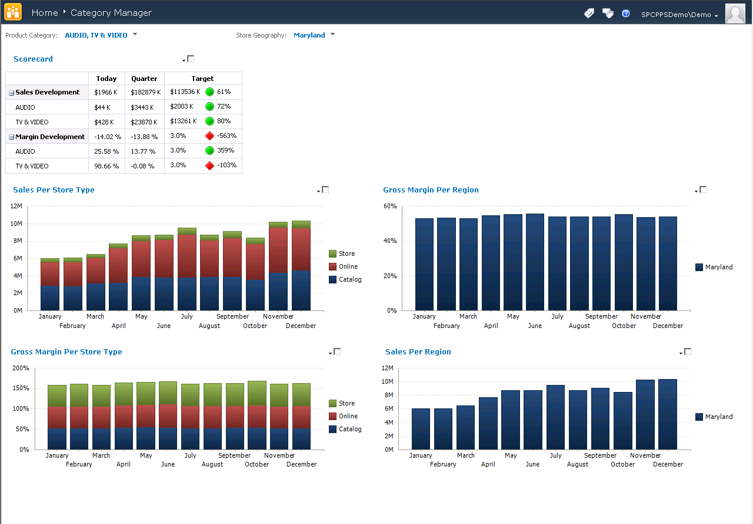
What is Performance Point Services for SharePoint 2010?

Slide 52
Performance Point Services New features
New visualization report – Decomposition Tree
Improved scorecards
Time Intelligence filtering improved
Connectable web parts
KPI Details report
Enhanced analytic reports

Slide 53
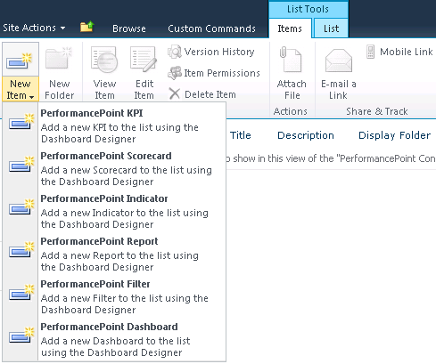
Content storage Content Types
Define new, edit and display actions & forms

Slide 54
DEMO
PerformancePoint services

Slide 55
<Demo - Performance Point Services>
Review configuration of PPS services
Estimated time : 5 minutes

Slide 56
VISIO SERVICES

Slide 57

Visio Services Features
Rendering
Full Fidelity rendering using
Down-level experience in PNG
Visual Refresh of Data Diagrams
Refresh diagrams connected to:
Supports Kerberos, SSO
Automatic refresh
SQL
Excel
SP Lists
OLEDB
ODBC
Custom
ODC

Slide 58
Visio Services Features
SharePoint Integration
Visio Web Access web part
JavaScript Mash-up API
Supports web part connections
Administration
Visio Services is a Shared Service
Customizable in Central Admin & PowerShell
Can tune performance to your hardware

Slide 59


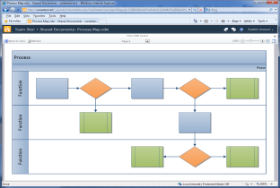


Architecture
4. Visio Services refreshes data and diagram
PNG/ XAML
5. Diagram rendered in browser
2. Upload it to SharePoint
VDW
VDW
Visio Services
Consumer
3. Consumer requests diagram
Creator
1. Create data connected diagram in Visio
Data Source

Slide 60
POWER PIVOT

Slide 61
















Reporting Services as a Data Source
Report-Based Data Feeds
Data Import
Published Reports
Publishing
SharePoint Farm
OLTP and OLAP Data Sources
Notes:
IT knows author, data sources, and users, great, but what about the refresh settings? These settings seemed to bother some IT pros. Can you prevent users/owners of BI solutions from changing these settings?
Operations Dashboard, how does it help IT folks to stay on top of the self-service BI game?
Bring details along the lines of customizations. Audience might want to change the default reports provided.

Slide 62
SQL REPORTING SERVICES

Slide 63
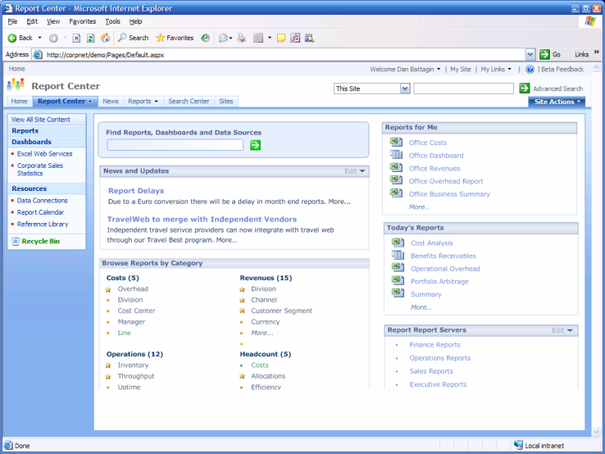
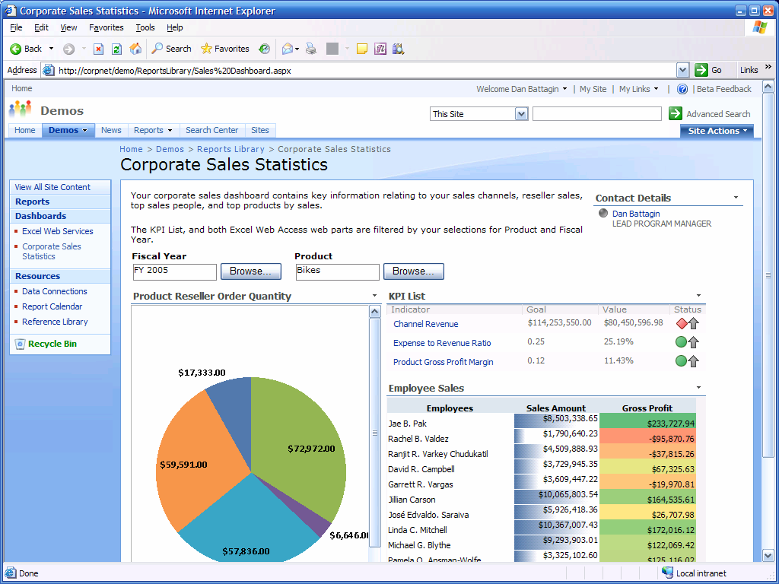
SharePoint Integration
Deep integration with the Microsoft SharePoint Technologies
Enables publishing, viewing, management, and delivery of reports
Provide report web part for hosting rich reports in BI dashboards
Leverage SharePoint collaboration and workflow capabilities with rich reporting
Shared security principles across Reporting Services & SharePoint

Slide 64










Reporting Services
Empower End Users
Timely access to information
Intuitive authoring
Powerful visualizations*
Share & Collaborate
Publish to SharePoint
“Grab and Go” access*
Componentize existing reports*
Increase IT Efficiency
Central deployment & management
Build reusable components for broad use*
Deliver analytics data through reports*

Slide 65
Reporting and challenges

Slide 66

Reporting Challenges
How Do You Deal With:
Data stored in multiple data sources
Limitations in native report engines
Inefficient report development processes
Pervasive delivery of information
Expensive, 3rd party reporting tools
Steep learning curves for new tools
Scalability and reliable report processing
Delivery of contextual business insight

Slide 67
10 Step Process (Common Practice)
Interview business users to create specs
Review all expressed needs, desires, fantasies
Start will full list of candidates
Give each report a name or description
Rate each report based on business value and the effort to build (scale of 1 to 10)
Prioritize the list of candidates
Group related reports
Review priorities with small group of users
Identify 10-15 reports & Negotiate a cutoff point
Handoff the lower priority reports back to the business experts

Slide 68
Resources:
http://technet.microsoft.com/projectserver/
http://msdn.microsoft.com/project/
http://www.microsoft.com/bi
http://sharepoint.microsoft.com
http://blogs.msdn.com/performancepoint
www.powerpivot.com
Twitter: @powerpivot
Facebook: PowerPivot

Slide 69
Questions?

Slide 70

© 2009 Microsoft Corporation. All rights reserved. Microsoft, Windows, Windows Vista and other product names are or may be registered trademarks and/or trademarks in the U.S. and/or other countries.
The information herein is for informational purposes only and represents the current view of Microsoft Corporation as of the date of this presentation. Because Microsoft must respond to changing market conditions, it should not be interpreted to be a commitment on the part of Microsoft, and Microsoft cannot guarantee the accuracy of any information provided after the date of this presentation. MICROSOFT MAKES NO WARRANTIES, EXPRESS, IMPLIED OR STATUTORY, AS TO THE INFORMATION IN THIS PRESENTATION.

Slide 71
APPENDIX

Slide 72
Business Intelligence Center Configuration

Slide 73
Business Intelligence Center Configuration
To configure OOB available reporting, you must do the following:
Add a login for the report author in SQL Server
Configure Excel Services
Configure Secure Store Service

Slide 74
Reporting Security Model
Reporting Security
User Access
Document Access
Data Access
What Can the User Do?
Author
Viewer
Administrator
What Data Can They Access?
Secure Store Profile
SQL Rights
What Content Can They Access?
Data Connections
Excel Document

Slide 75
Login Preparation
Create Windows domain groups for report viewing and report authoring
Add these groups to SQL Server as a logins
Grant the logins db_datareader to the EPM Reporting database

Slide 76
BI Center Security Model
BI Center does NOT use Project Server security model
Uses combination of SharePoint Server 2010 and Single Sign-On security features
Three core security roles are provided by SharePoint Server
Use AD groups for easy management
Group | Target Audience
Full Rights | Site Administrator
Hierarchy Manager | IW Report Author
Viewers | IW Consumer
Notes:
PWA = Project Web Access

Slide 77
Excel services configuration

Slide 78
Configure Excel Services and Secure Store Configure Relational and Analysis DB access
Project Web Access -> Business Intelligence Center
Excel Workbook
Excel
Services
Secure Store
Application Profiles
Office Data Connection
Database Server
Reporting
DB
Analysis
DB

Slide 79
Excel Services - Security Setup
Report Author
Report Consumer
Excel Client does not use Secure Store Service (SSS)
Requires direct authentication against SQL
Setup author group with db_datareader rights to RDB
Excel Services uses Secure Store Service (SSS)
Setup app profile in SSS with service profile that has db_datareader rights
Authenticate the security group of users to use the profile

Slide 80
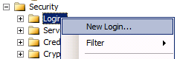
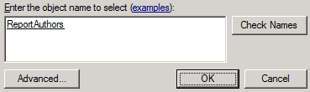
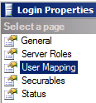
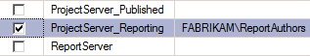
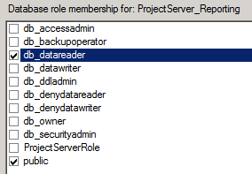
Configure Secure Store Service
To configure BI Center reports based on Excel Services, you must do the following steps:
Add a login for the ReportAuthors group in SQL Server
Configure Excel Services
Configure Secure Store Service

Slide 81
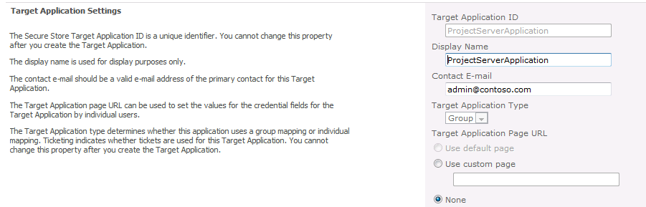
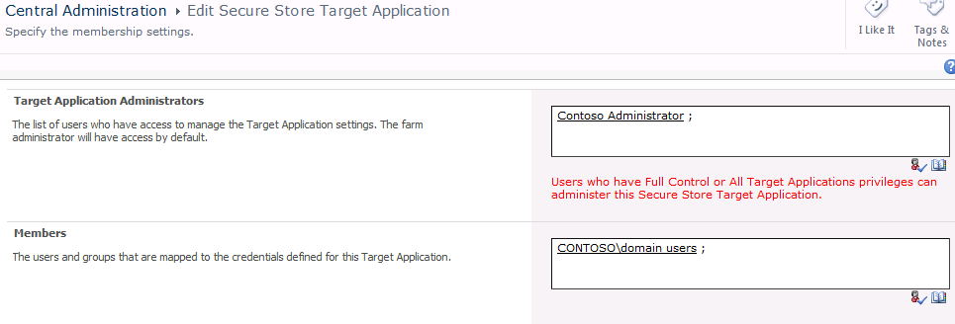
Configure Secure Store Service
Central Administration -> Application Management -> Manage service applications-> Secure Store Service
Create a New enterprise application definition
“ProjectServerApplication” is the exact string needed for Application Name
Windows Authentication for Authentication Type

Slide 82
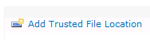
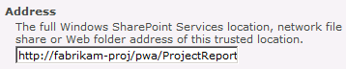
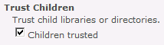
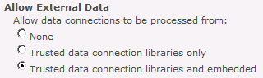
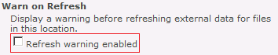
Trusted File Location
Manage Excel Services -> Trusted File Location
Add the URL of the PWA Report Center as a Trusted File Location
Confirm that “Children trusted” checkbox is selected
Fill in “Allow External Data” area
Select “Trusted data connection libraries and embedded”
Clear “Refresh warning enabled”

Slide 83
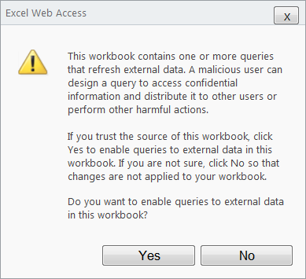
If “Refreshed warning enabled” is not cleared

Slide 84
Office Data Connections (ODC)
ODC’s are external files which can be used by multiple Excel Reports
These files contain:
Connection info to connect to target database
Description of data to be retrieved. May include SQL query.
ODC’s are stored in the Data Connection library in the PWA Report Center
Notes:
PWA = Project Web Access

Slide 85
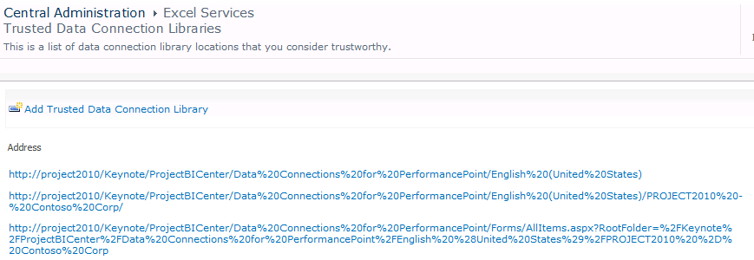
Trusted Data Connection Library
Copy the URL for PWA Report Center data connection library
Central Administration -> Manage Excel Services -> Trusted Data Connections
Configure that URL as a trusted data connection

Slide 86
REST
No need for complex JS
Some solutions as simple as embedding HTMLs
Embed IFRAMES or get fancy and AJAX it
Leverage everything in the Workbook

Slide 87
Why a RESTful Interface?
Why REST
It is a natural fit for SharePoint data
Item == resource
Uniform interface and addressing scheme
Low barrier of entry, interoperability
Why ADO.NET Data Services
RESTful conventions & frameworks for data
Builds on top of standard AtomPub
Exactly the sort of convention we needed
Consistent tools and client libraries

Slide 88
OLAP Configuration

Slide 89
Configure Analysis Services
Farm Admin account needs administrative rights to SQL Analysis Services
Add account to OLAP users local group:
SQL Server 2005 : SQLServer2005MSOLAPUser$<SERVERNAME>$MSSQLSERVER
SQL Server 2008 : SQLServerMSASUser$<SERVERNAME>$MSSQLSERVER
Add account as Analysis Services server administrator
Notes:
SQL AS = SQL Server Analysis Services

Slide 90
SQL Analysis Management Objects (AMO)
Required to enable Project Server OLAP cube building, may be completed after initial install but before cube building
SQL Server 2005 Native Client, (regardless of SQL Server database engine version
SQL Native Client matching SQL Server database engine version
SQL Server Analysis Management Objects (AMO) according to DB ver. (2005/2008)
Required on Project Server machines and on the SQL Server Analysis Services machine
Notes:
AMO = Analysis Management Objects

Slide 91
PERFORMANCE POINT SERVICES

Slide 92

What are BI dashboards?
Visualizations
Spreadsheets
Metrics
Diagrams
BI Dashboard
Lists

Slide 93





Aggregate what?
Content
Spreadsheets
Diagrams
PerformancePoint Reports
Reports
Data
Spreadsheet
List
Data Warehouse
3rd Party

Slide 94
Shared Services and Deployment Web application setup
Pre-existing WFE Components
Web parts
Web Services
Dashboard Designer

Slide 95
Shared Services and Deployment Web application setup
Site Collection features
PerformancePoint Content Types
BI Center site template & definition
Site feature
List and Document Library templates
What about Enterprise and Publishing Infrastructure features?

Slide 96
Content storage Lists and Document Libraries
Dashboard Designer Connectivity
Lists
Contains dashboards, reports, scorecards, filters, KPIs and indicators
Document libraries
Contains “exported” dashboards and data sources

Slide 97
SQL REPORTING SERVICES

Slide 98
SharePoint Integration
Deep integration with the Microsoft SharePoint Technologies
Enables publishing, viewing, management, and delivery of reports
Provide report web part for hosting rich reports in BI dashboards
Leverage SharePoint collaboration and workflow capabilities with rich reporting
Shared security principles across Reporting Services & SharePoint

Slide 99
Reporting Services 2008 Enterprise Reporting Platform
Author Impactful Reports
Powerful Designers
Flexible Report Layout
Rich Visualizations
Manage any Workload
Enterprise Scale Platform
Central Deployment
Strong Manageability
Deliver Personalized Reports
Interactive Reports
Rendering in the Format Users Want
Delivery to Location Users Want

Slide 100
Reporting Services
Empower End Users
Timely access to information
Intuitive authoring
Powerful visualizations*
Share & Collaborate
Publish to SharePoint
“Grab and Go” access*
Componentize existing reports*
Increase IT Efficiency
Central deployment & management
Build reusable components for broad use*
Deliver analytics data through reports*

Slide 101
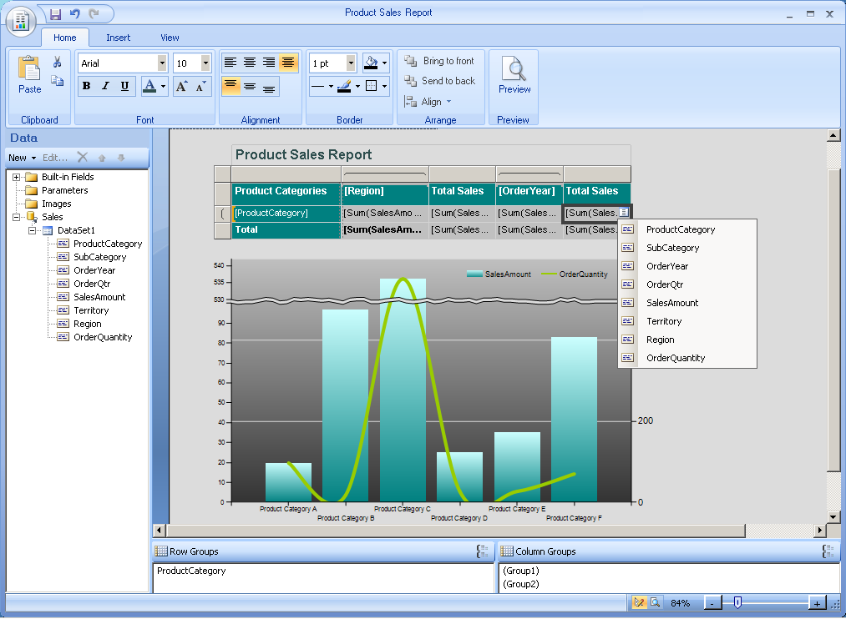
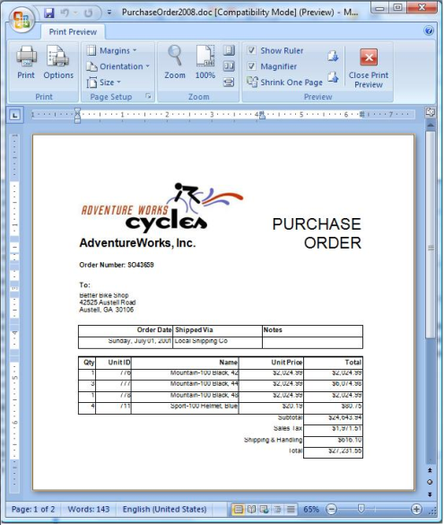

Empower End Users
Timely access to information to drive better decisions
PowerPivot model as a data source
SharePoint list as a data source
Access to relational and multidimensional data
Support for multiple data sources within a single report
Intuitive, Office-optimized authoring environment
Quickly design queries, reports and charts through powerful wizards
Edit and customize reports regardless of where they were initially designed
Powerful visualizations including map, sparklines, and tablix
Deliver reports in format that make the most sense for the end users
Report as data sources to PowerPivot for Excel analysis (ATOM Feed)
Render reports in fully editable Microsoft Office formats including Word and Excel
Rendering in most common formats including HTML, PDF, CSV, XML, and Image (TIFF)

Slide 102
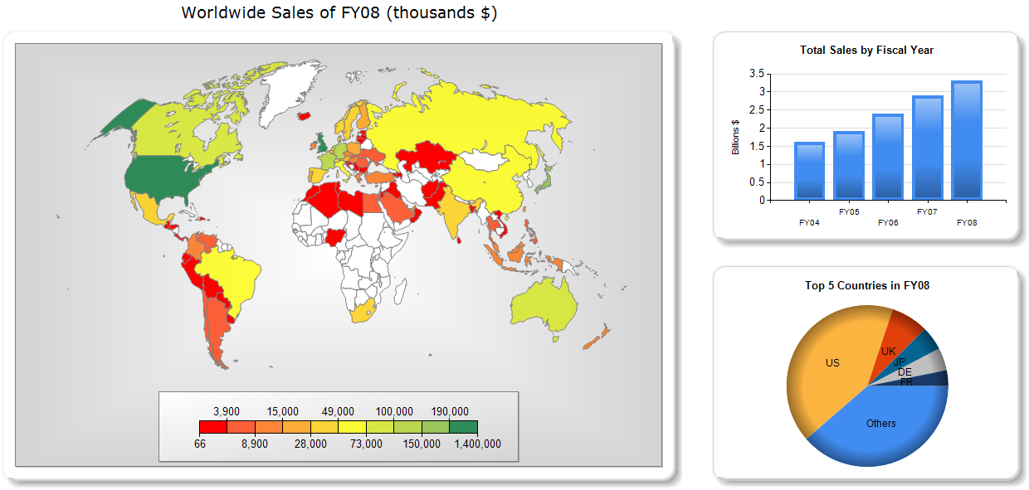
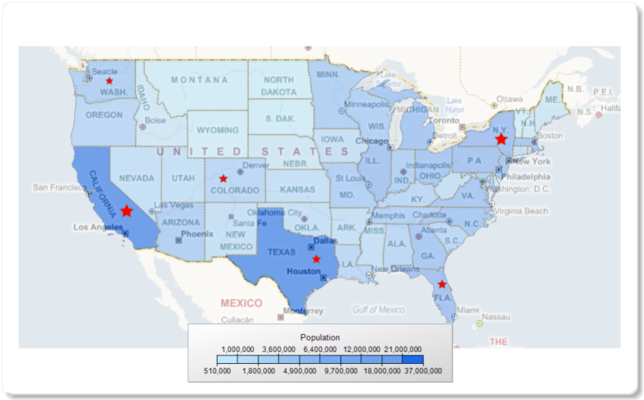
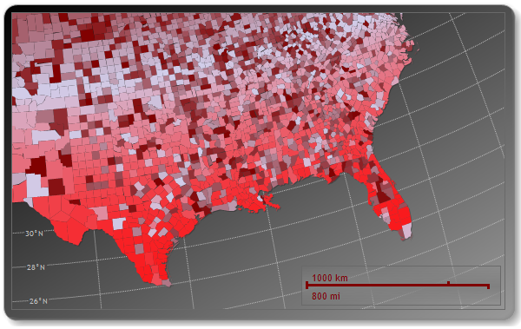
More Powerful Visualizations
Get more value out of your data
“Mash up” business information with geographic representation
Rich visualization of geospatial data
Mapping, Routing, Custom Shapes, …
Support for SQL Spatial
Integration with Bing Maps

Slide 103
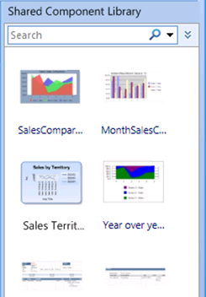
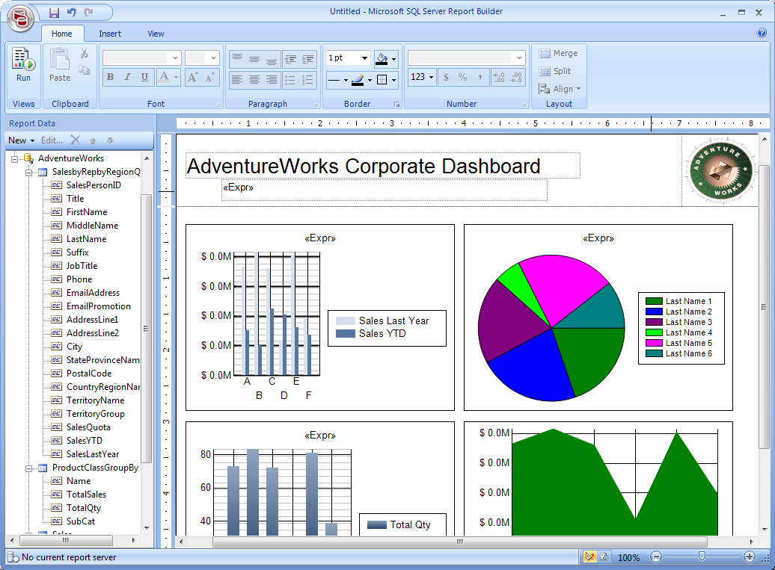

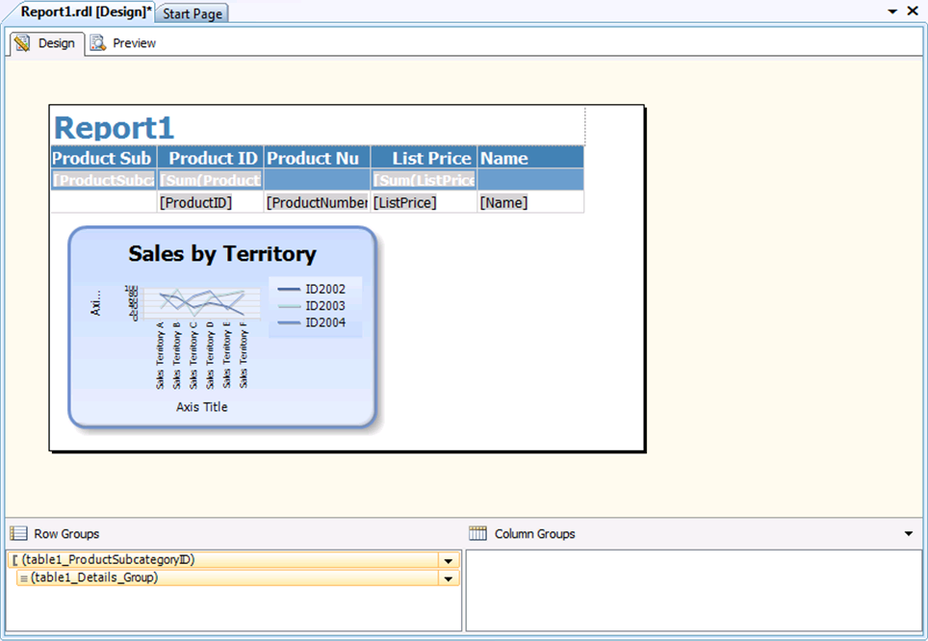

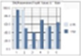

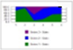
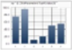

Share & Collaborate
Report Part Gallery
Source Report
New Report
Capitalize on Existing Reports
Reusing common report elements helps to accelerate report creation, cut down costs, and increase end-user adoption. SharePoint provides the central location for users to access a library of existing reports and identify desired reusable content .

